Slide 1

Logistics & Supply Chain
Performance Dashboard
A Power BI project analyzing order fulfillment, warehouse efficiency,
and sales performance across the United States.
US Regional Sales Data · Star-Schema Model · 12 DAX Measures

Slide 2





Project Overview
Objective
Key Questions This Report Answers
Build an interactive Power BI report that evaluates how efficiently orders move through the supply chain — from procurement to final delivery — and highlights which warehouses, sales teams, and products drive performance.
How is revenue trending across regions and time?
How long does fulfillment take, from procurement to delivery?
Scope
Single-country dataset (United States)
3-year historical window (2018–2020)
Order-level transactions with full date lineage
Star-schema model built for scalability
Which warehouses deliver fastest and generate most revenue?
Which sales teams and products perform best?
Logistics & Supply Chain Performance | Power BI Project
2

Slide 3




Data Source
US Regional Sales Data (Kaggle) — a clean, order-level transactional dataset covering procurement, ordering, shipping, and delivery dates for sales made across the United States.
7,991
16
1
4
Order Records
Source Columns
Country (USA)
Date Fields per Order
Data Structure
1 Fact Table
6 Dimension Tables
Date Range
Sales — one row per order line
Warehouse, Sales Team, Customer, Store, Product, Date
January 2018 – December 2020
Logistics & Supply Chain Performance | Power BI Project
3

Slide 4

Fact Table — Sales
Column | Description
OrderNumber | Unique identifier for each order (primary key)
Sales Channel | How the order was placed (In-Store, Online, Distributor, Wholesale)
WarehouseCode | Warehouse that processed the order (→ Dim_Warehouse)
ProcuredDate | Date the ordered products were sourced
OrderDate | Date the customer placed the order
ShipDate | Date the order left the warehouse
DeliveryDate | Date the order reached the customer
CurrencyCode | Currency of the transaction (USD)
Column | Description
SalesTeamID | Sales team handling the order (→ Dim_SalesTeam)
CustomerID | Customer who placed the order (→ Dim_Customer)
StoreID | Store associated with the order (→ Dim_Store)
ProductID | Product ordered (→ Dim_Product)
Order Quantity | Number of units ordered
Discount Applied | Discount rate applied to the order
Unit Cost | Cost per unit to the company
Unit Price | Price per unit charged to the customer
Logistics & Supply Chain Performance | Power BI Project
4

Slide 5
Dimension Tables
Dim_Warehouse
Dim_SalesTeam
Dim_Customer
Warehouse code, name, city, state, region and storage capacity
Sales team ID, name, covering region, manager and team size
Customer ID, name, segment, location and customer-since date
Dim_Store
Dim_Product
Dim_Date
Store ID, name, store type, location and store-open date
Product ID, name, category, sub-category and unit of measure
Full calendar table — year, quarter, month, weekday, week number
Logistics & Supply Chain Performance | Power BI Project
5

Slide 6
Data Model — Star Schema
Dim_Warehouse
Dim_SalesTeam
Dim_Date
Dim_Customer
FACT: Sales
Dim_Store
Dim_Product
Each dimension connects to Sales through its ID column. OrderDate drives the active relationship to Dim_Date; ProcuredDate, ShipDate and DeliveryDate use USERELATIONSHIP() for fulfillment-speed measures.
Logistics & Supply Chain Performance | Power BI Project
6

Slide 7
Report Pages
01
02
Overview
Fulfillment Speed
Business performance at a glance
Order-to-delivery timing
03
04
Warehouse Performance
Sales Team & Product
Distribution hub efficiency
Team and product performance
Logistics & Supply Chain Performance | Power BI Project
7

Slide 8
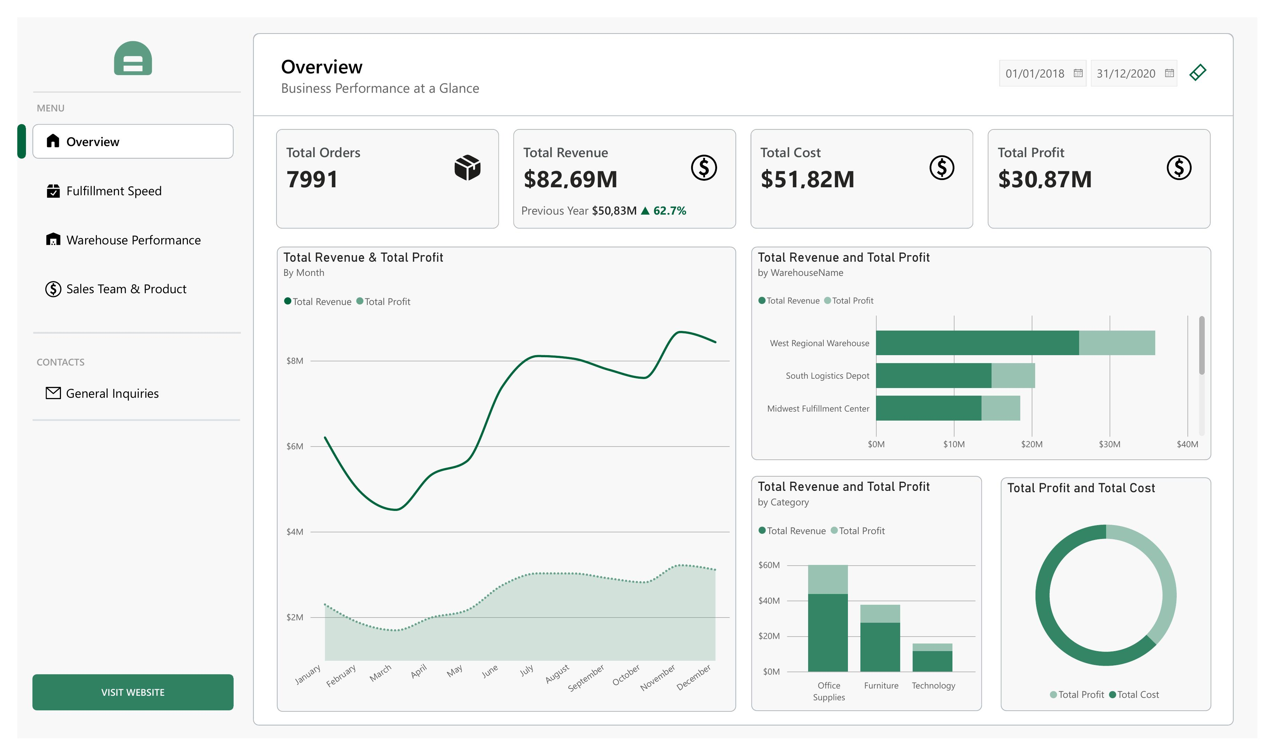
Page 1 — Overview
Business performance at a glance
What's on this page
KPI cards: Total Orders, Revenue, Cost, Profit
Revenue & Profit trend by month
Revenue & Profit by Warehouse and Category
Profit vs. Cost breakdown
Logistics & Supply Chain Performance | Power BI Project
8

Slide 9
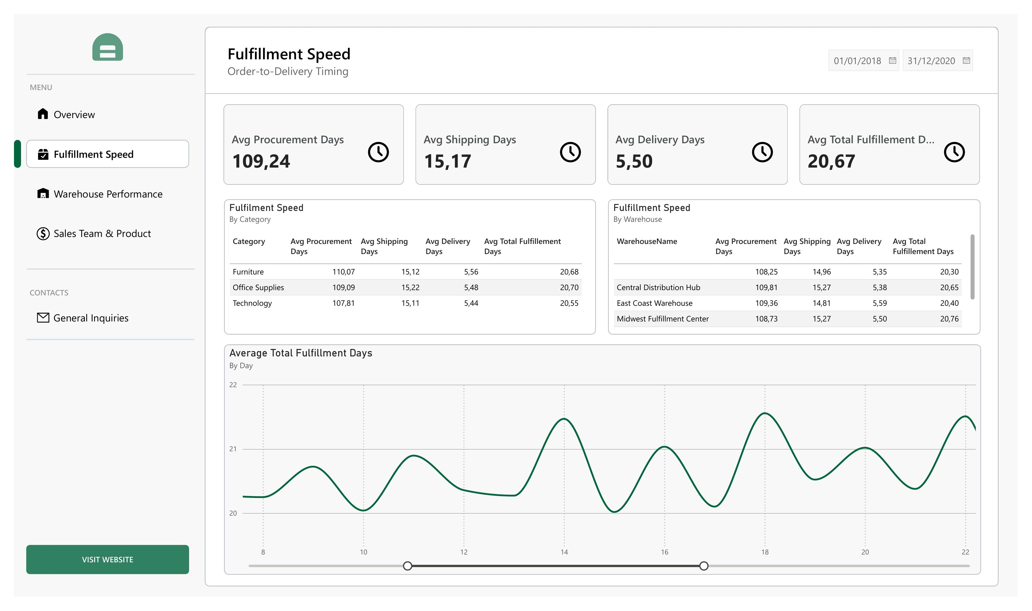
Page 2 — Fulfillment Speed
Order-to-delivery timing
What's on this page
KPI cards: Avg Procurement, Shipping, Delivery, Total days
Fulfillment speed by Category
Fulfillment speed by Warehouse
Daily trend of total fulfillment time
Logistics & Supply Chain Performance | Power BI Project
9

Slide 10
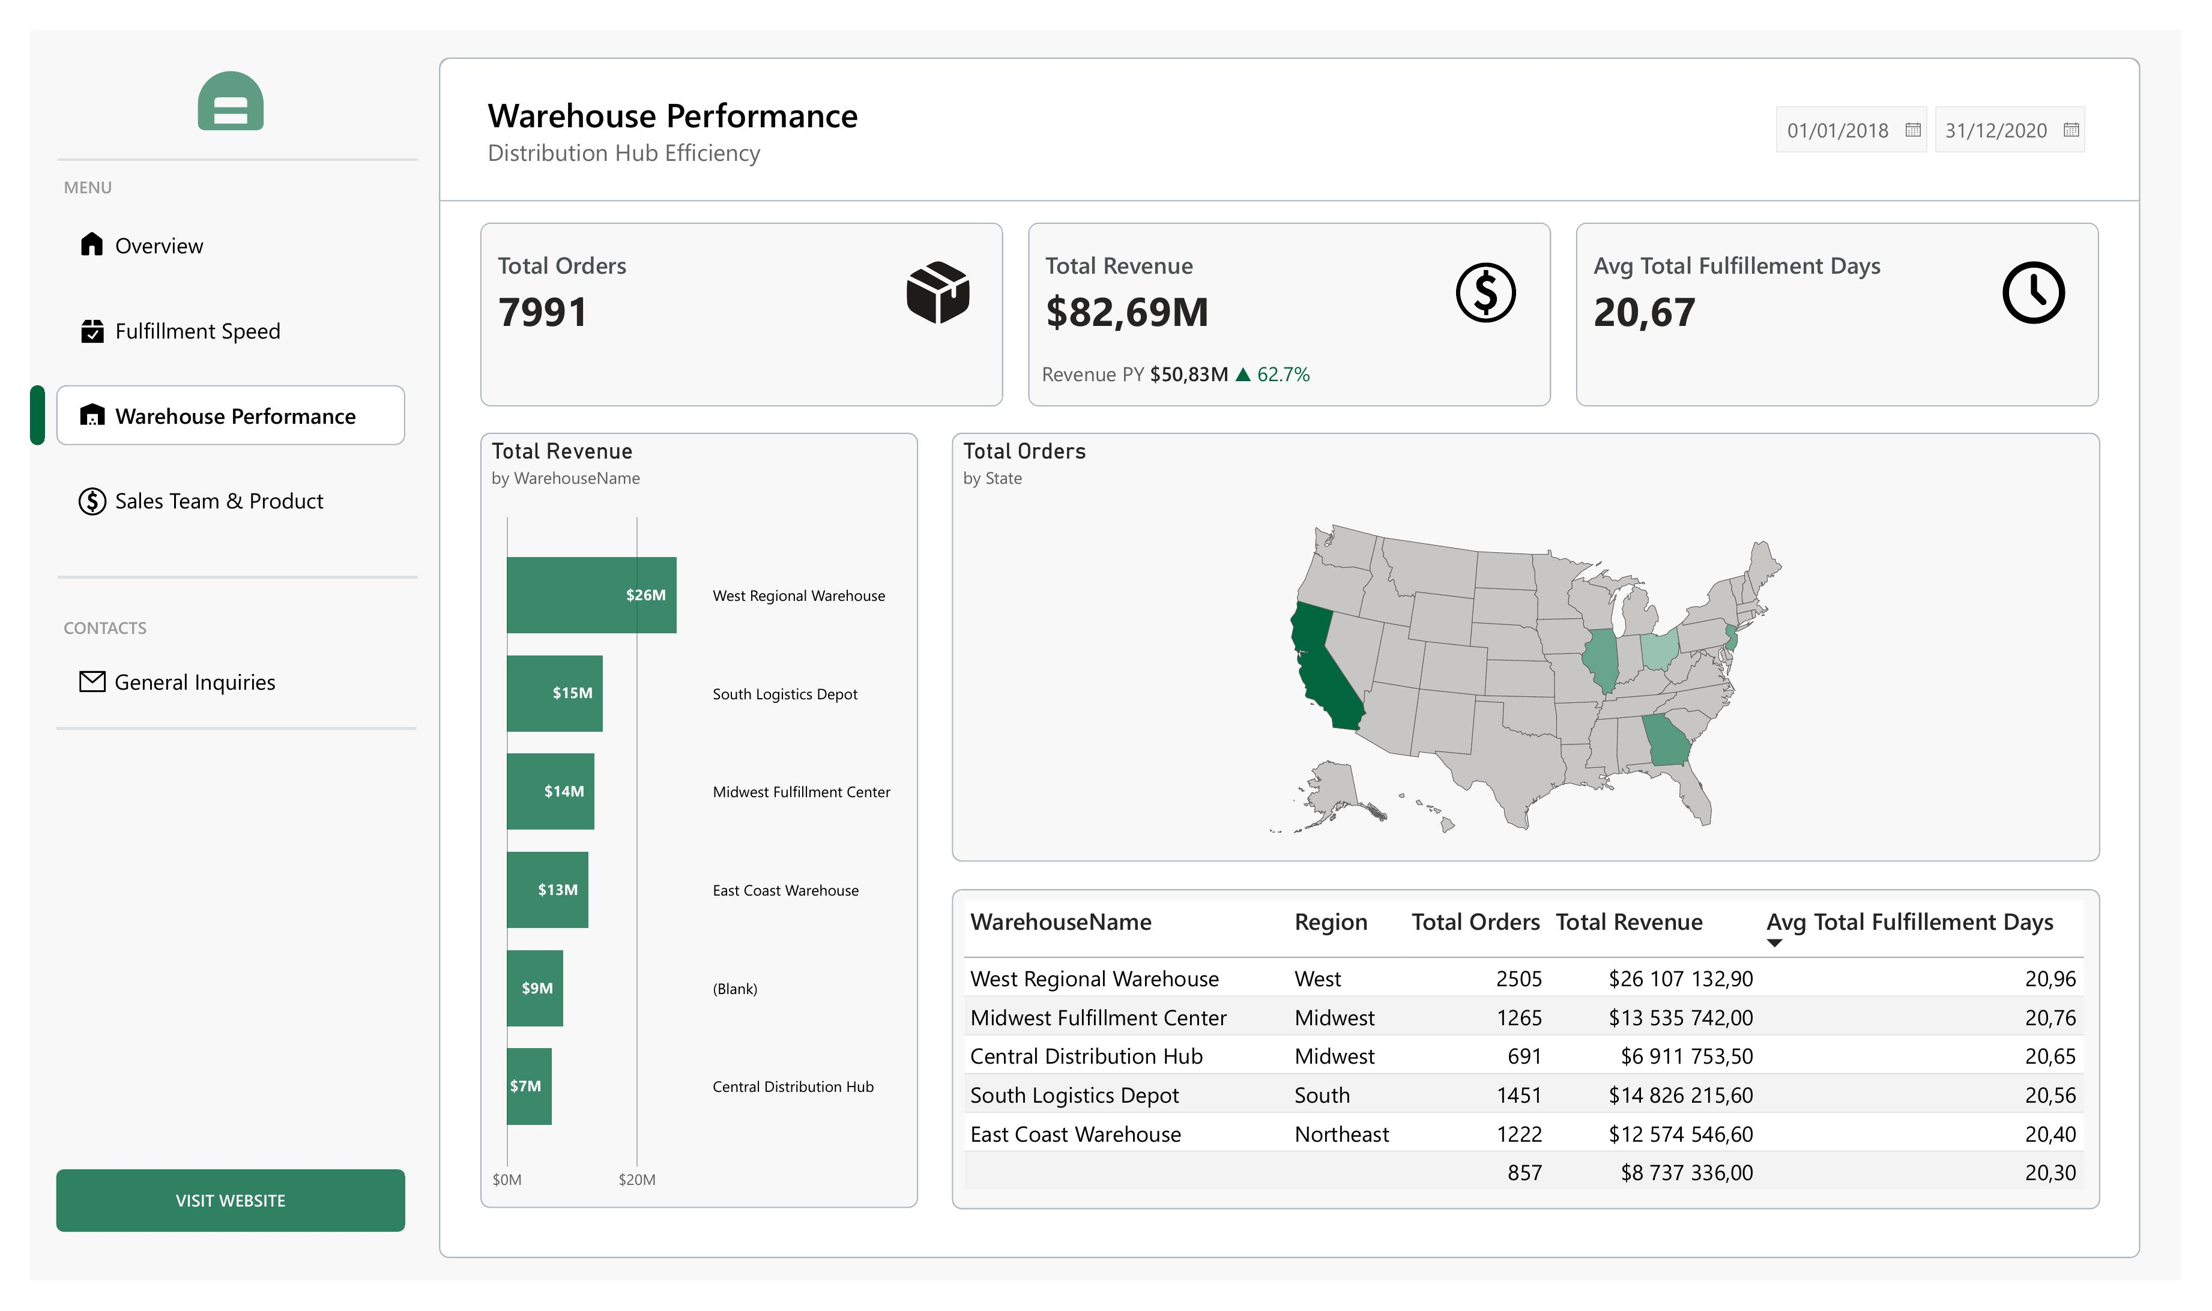
Page 3 — Warehouse Performance
Distribution hub efficiency
What's on this page
KPI cards: Orders, Revenue, Avg fulfillment days
Revenue by Warehouse
Orders by State (map)
Warehouse detail table, ranked by speed
Logistics & Supply Chain Performance | Power BI Project
10

Slide 11
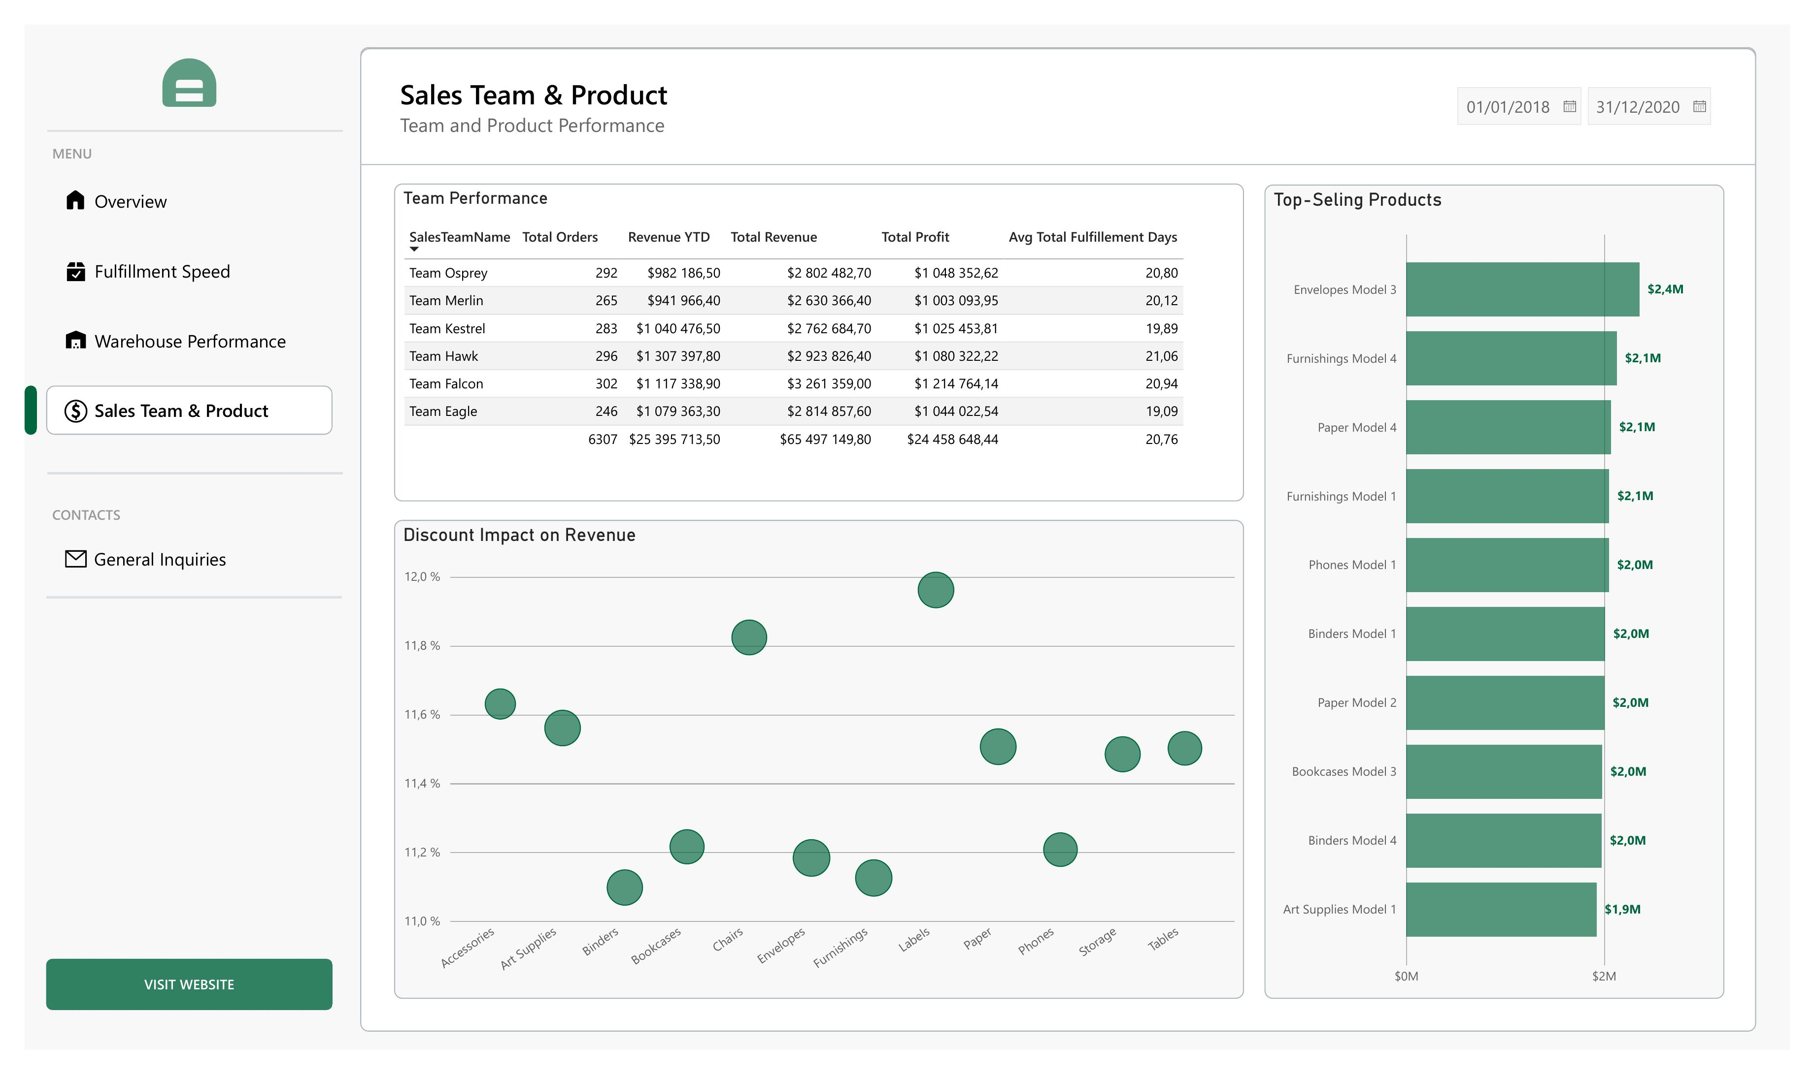
Page 4 — Sales Team & Product
Team and product performance
What's on this page
Team performance table (orders, revenue, profit)
Discount impact on revenue by category
Top-selling products, ranked by revenue
Logistics & Supply Chain Performance | Power BI Project
11

Slide 12
Key DAX Measures
Sales & Revenue
Fulfillment Speed
Time Intelligence
Total Orders
Total Revenue
Total Cost
Total Profit
Avg Discount
Avg Procurement Days
Avg Shipping Days
Avg Delivery Days
Avg Total Fulfillment Days
Revenue YTD
Revenue PY (Same Period Last Year)
Revenue Growth %
Logistics & Supply Chain Performance | Power BI Project
12

Slide 13

Deliverables
.pbix Power BI File
Fully built report with 4 interactive pages and applied theme
Star-Schema Data Model
1 fact table + 6 dimension tables with defined relationships
12 DAX Measures
Covering sales, fulfillment speed, and time intelligence
Data Dictionary
Column-level documentation of the fact and dimension tables
Logistics & Supply Chain Performance | Power BI Project
13

Slide 14
Thank You
Logistics & Supply Chain Performance Dashboard — built in Power BI

